Slide 1
EVENT-BASED DATA ASSURANCE
WORKSHOP #3: ONTOLOGY (2)
18th February 2020

Slide 2
Workshop schedule
W/s | Date | Deliverable | Agenda | Attendees
KO | 29/01 1-4pm | Common understanding | Questions Problem statements Expressions of interest | FB Technical Architect HMRC Technical Architect HMRC Innovation Lead
#1 | 05/02 1-4pm | Standards | Standards to implement and communicate shared knowledge base used in event-based data assurance
#2 | 12/02 1-4pm | Metadata model | Reasoning models for data assurance Classification Events Chains / sequences / methods Actors (e.g. source of events) Relationships (e.g. linking IDs) Supporting metadata Schema / headers Mandatory Optional
#3 | 19/02 1-4pm
#4 | 26/02 1-4pm
#5 | 04/03 1-4pm | Security | Security assessment of proposed standards and metadata model | NCSC representative
#6 | 11/03 1-4pm | Rules of engagement | Boundary of open alliance Scalable / mutual contractual agreements for value exchange Value exchange mechanisms Publication of / subscription to events Permissioning (including consent) Use of standards and metadata model Governance | HMRC Innovation Lead HMRC Stakeholders x2 GDS representative(s)
#7 | 18/03 1-4pm
#8 | 25/03 9am-12

Slide 3
Agenda
Recap from Workshop 2 12.00 – 12.10
Domain knowledge we need to represent 12.10 – 13.30
Components of the toolkit we need to specify 13.30 – 14.45
Look forward to Workshop #4 14.45 – 15.00

Slide 4
Section 1
Recap from Workshop 2

Slide 5
What kind of knowledge do we want to represent? Use case specific
The consignment originates from the country which it states it does?
This consignment complies with regulatory requirements?
This consignment contains what is stated on the manifest?
This freight forwarder/trader/importer/carrier has a history of not being stopped?
This freight forwarder/trader/importer/carrier has a significant number of imports which have been verifiably "good“?
Has this freight forwarder/trader/importer/carrier been seen before?
Is this freight forwarder/trader/importer/carrier behaving in a way which is unusual?
Is this freight forwarder/trader/importer/carrier linked to other traders or trades which have resulted in a successful intervention?

Slide 6
What kind of knowledge do we want to represent? Across the ecosystem
Declarative (use case specific) – what things exist and how do they relate to each other?
Entity graph: People and Things
Information graph: scalar values and schemas used
Note: this makes knowledge explicit and shareable -> URIs vs. DIDs
Temporal (ecosystem and use case specific) – what has happened over time?
Journey events (use case specific)
Assurance events (use case specific and ecosystem)
Data access events (ecosystem)
Instructive (ecosystem) – what are you allowed to do / obliged to do?
Permissioning and access management
Contracting, accounting and settlement
Other workflows (e.g. notification), including acting “on behalf of” other actors
Asserted and inferred (ecosystem) – who has said what, when (and why)?
Focus of today’s initial drafting session

Slide 7
Section 2
Domain knowledge

Slide 8
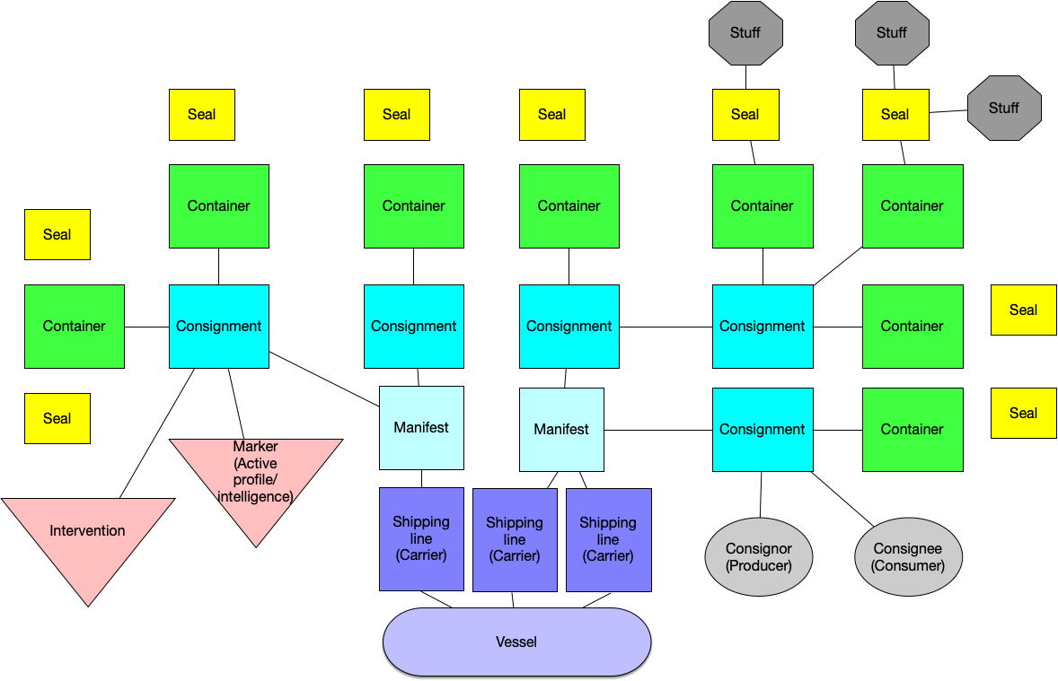
Configuration of a ship

Slide 9
What kind of expertise might be available?
I attest that…: | I know this because…:
The ship did / did not deviate from its planned route | The Captain’s log tells me this is true
 | The logs of the Port Authorities visited tell me this is true
 | The ship’s geolocation data tells me this is true
The V1 documentation has / has not been tampered with | It does / does not match the copy sent by country of export
 | It has been signed cryptographically
The container’s seal was / was not broken on arrival in UK | A trusted agent physically checked it
 | A senior employee physically checked it
The configuration of goods does / does not match the V1 | A trusted agent physically counted the goods
 | A senior employee physically counted the goods
The goods arriving are / are not the same goods that left | An agent / employee has compared them to a description
 | An agent / employee has scanned the bar code / RF code
 | A 3D scanning device has been used
… | …

Slide 10
What kind of decisions does this expertise affect?
Given these conditions...: |  | …I will assign a status of…: |  | …and then allocate resources:
Evidence of negative indicators: Ship deviated from course OR V1 has been tampered with OR Seal was broken on arrival OR Configuration did not match OR Goods are not the same OR … |  | High risk |  | 100% inspection rate (Tiny minority of volume)
No evidence (positive or negative) It is uncertain if ship deviated It is uncertain if V1 tampered It is uncertain if seal intact It is uncertain if config matches It is uncertain if goods are same … |  | Medium risk |  | 20% inspection rate (Significant minority of volume)
Evidence of positive indicators Ship did not deviate AND V1 has not been tampered AND Seal was intact on arrival AND Configuration matches AND Goods are the same AND … |  | Low risk |  | 1% inspection rate (Majority of volume)

Slide 11
Which actors are producing / consuming the expertise?
Shipping Co.
HMRC
FSA
Routing
Sample test
Goods match
Should we send an FSA inspector to inspect this consignment?
V1 documentation
Configuration check
…
Provenance
Seal check
Container inspection
Country of Export
Port Health

Slide 12
Section 3
Components of the toolkit

Slide 13
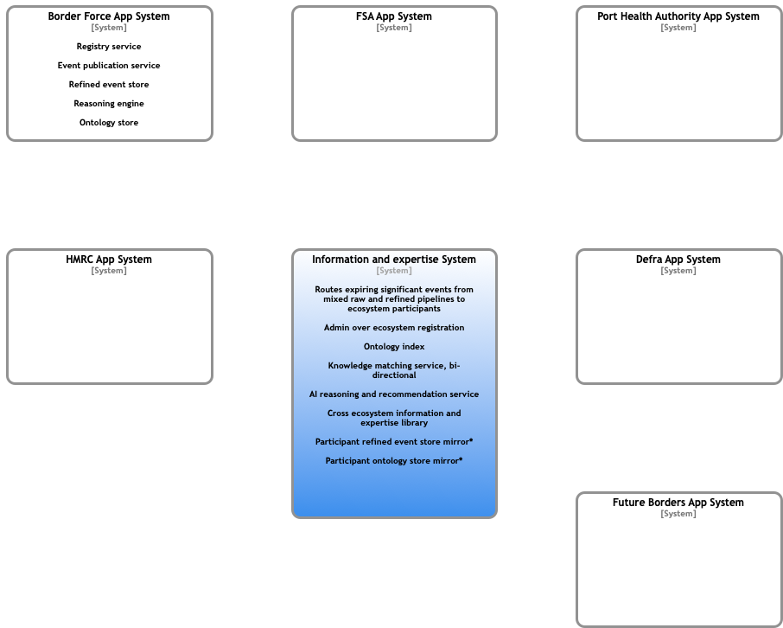
OEF Ecosystem – Operations System Context Diagram Extracting both raw data and refined data from a mixed economy of ‘Thing’ Event Pipelines

Slide 14
OEF architecture constraints
Systems Thinking to provision for evolving ecosystems
API First
Negotiable protocols and resource representations
Event information exchange model agnostic
Event pipeline technology agnostic through a standard/specification for events
Observable at design time and run time, message passing (channels)

Slide 15
Target architecture (for discussion)
Registry: a formal record of the participants authorised to operate within the ecosystem as both Event Consumers and Event Providers
Ontology: a conceptual model of the domain of interest shared by the ecosystem, formulated as an ontology expressed in a logic-based language
Directory: a mapping between the conceptual model and the logical/physical level of the information system that facilitates discovery and matching between ecosystem participants
Exchange services: the services and protocols that manage both access to the information and any concomitant value exchange between participants
Data: the logical/physical manifestation of the information being made available for access as part of the ecosystem, in conformance with the published ontology
Reasoning: the ability to reason over information (including Event data accessed via the ecosystem) to support decisions and applications that may be specific to each participant

Slide 16
Registry
The registry is a role that a system might perform by mediating the creation and verification of identifiers, keys and other relevant data pertaining to the ecosystem participants that are authorised to operate as Event Consumers and Event Providers
Information accessible through the registry must be machine readable and must include:
Identifier: unique identifier that identifies the entity authorised to participate in the ecosystem
Authentication: a means to authenticate the entity identified by the identifier
Verifiable credentials: materials that authorise the entity to participate in the ecosystem
The registry may be implemented as a centralised, federated or decentralised identity management system
The Open Ecosystem Federation may comprise of more than one ecosystem operating more than one implementation of a registry
It is a condition of participation in the Open Ecosystem Federation that ecosystems implement registries that are interoperable with all other registries within the Open Ecosystem Federation

Slide 17
Ontology
The ontology describes the conceptual model of the domain of interest. For all ecosystems within the Open Ecosystem Federation, the primary domain of interest is data assurance.
The ontology is used by all participants to derive a common conceptual understanding of the terms that are referenced by any given Event within any ecosystem or context. The ontology must be expressed in RDF, RDFS and OWL (i.e. a logic-based, machine-readable language).
Participants must map proprietary data schema to the ontology and – where they reference data objects in their directory information that are not already described in the ontology – participants must publish definitions of these incremental terms as part of the ontology.
The Open Ecosystem Federation may comprise multiple different ecosystems – i.e. groups who collaborate to facilitate data assurance within different contexts and use cases.
There is no obligation for one ecosystem to collaborate with another ecosystem, but the Open Ecosystem Federation is designed to enable this to happen, where there is value or need.
The ontology may [must?] be published to any participant in the Open Ecosystem Federation

Slide 18
Directory (1 of 2)
The directory is a role that a system might perform by mediating the discovery and matching of resources associated with the concepts described in the ontology. Participants use the directory to engage with the information system at a practical level.
The directory information set that Event Providers can choose to make available may include:
Scope of information that they provide
Reference information (e.g. identification schemes / registries used to identify target entities)
Condition set that governs access to instance data (e.g. consent from subject, etc.)
Service endpoint(s) which govern access to the scope of information described
Directory information set that Event Consumers can choose to make available may include:
Scope of information that they consume
Reference information (e.g. target entities for which the information is sought)
Permissions that they hold for the instances that they seek (e.g. consent from subject)
Service endpoint(s) to which the information sought can be posted
The purpose of the directory is to facilitate automated discovery and matching between ecosystem participants who are acting as either Event Providers and Event Consumers. As with the registry, therefore, directory information must be machine readable. Furthermore, directory information must be understandable – i.e. it must reference terms that have been defined in the ontology.
Participants are free to include more or less directory information depending on their own needs and may choose to make their directory information available to none, some or all participants in the ecosystem. Clearly, the richer the directory information and the more widely that it is available, the more interaction that a participant is likely to have with the rest of the ecosystem.

Slide 19
Directory (2 of 2)
Directory information must be machine readable. Furthermore, directory information must be understandable – i.e. it must reference terms that have been defined in the ontology.
Participants may include more or less directory information depending on their own needs and may choose to make their directory information available to none, some or all participants in the ecosystem. The richer the directory information and the more widely that it is available, the more interaction that a participant is likely to have with the rest of the ecosystem.
The identification schemes used by the participant to identify individual entities form an important component of the directory information set. These might fall into one of four types:
Self-sovereign identifiers through which the identified entity exerts agency
As a registered participant in the Open Ecosystem Federation
As an actor in the Open Ecosystem Federation (but not a registered participant)
Common identifiers (e.g. public asset registers, LEIs, Web IDs, etc.)
Application-specific identifiers (e.g. bank account, email address, employee number, etc.)
Where the participant references [their own] application-specific identifiers, it may also choose to offer an entity resolution service to allow other participants [and actors] to assert linkages between entities that are described using different identification schemes

Slide 20
Exchange services
If Participant B does not satisfy Participant A’s conditions of access to the resources Participant A controls, Participant A must offer protocols that enable Participant B to acquire the permissions and commit to the value exchange that are required.
These protocols may not be standardised or digitally executable. Each participant is free to specify their own conditions for access to the resources that they control, and – with that – the protocols required to satisfy those conditions .
Where the protocols are digitally executable, participants may publish service endpoint(s) that enable their execution. Where protocols are not digitally executable, participants may publish a URL that resolves into a description of the protocol.
The services that execute the protocols must make the outcome of each transaction available to the relevant parties as an Event. In this way, Events can be used as permissions to satisfy conditions of access in an automated, machine readable way.
Value exchange mechanisms are described as a rule of engagement, not a technical requirement.

Slide 21
Data
Data schema used by individual ecosystem participants are likely to be application-specific.
Participation in the Open Ecosystem Federation does not require the standardisation of the different applications that collaborate in an ecosystem. Neither does it require the integration of data schema required to support them.
Ecosystem participants must, however, map their proprietary data schema to the ontology used by the ecosystem, such that the directory information set is universally expressed as concepts that are described by that ontology.
If necessary, participants must publish extensions to the ontology to reflect concepts that are unique or idiosyncratic to their own data schema, such that other participants can interpret these concepts in the context of others described in the ontology.
Participants must also maintain a transformation layer that executes the mapping between their own data schema (logical/physical layer) and the ontology (conceptual layer) such that Event information is made available to other participants as the latter.

Slide 22
Appendix
Supporting slides

Slide 23
Common statement structure
Note: would the use of DIDs remove any need for this?
Statement Identifier
Statement Timestamp
Statement Location
Speaker Signature(s)
Batch ID
House keeping
Speaker
Subject
Predicate
Object
Account
System
OBO
Publisher / TSP
Note: does this imply a particular architecture?
Note: does this imply a particular architecture?
Source: Factern’s Metadata Meta Protocol (MDMP)

Slide 24
Common event structure
Header
Payload
House keeping
Speaker
Common Schema
Subject
Predicate
Object
Subject
Predicate
Object
Subject
Predicate
Object
Subject
Predicate
Object
Subject
Predicate
Object
…
…
…

Slide 25
Example event schema – Declare an Entity
Avttribute | Type | Mandatory | Description
value_instance | ATTRIBUTE_VALUE_ID | Yes | The ID of the attribute value instance assigned by the Entity identifying it
target | ENTITY_ID | Yes | The ID of the Entity to whom the attribute value instance relates
attribute_type | ATTRIBUTE_ID | Yes | The ID of the attribute type to which the attribute value instance relates
source_system | ENTITY_ID | Yes | The ID of the system that stores / provided the attribute value instance
timestamp | Time:date | Yes | The time:date that the attribute value instance was sourced
source_transaction | TRANSACTION_ID | No | The ID of the API call/transaction which sourced the attribute value instance

Slide 26
Example event schema – Compare Values
Avttribute | Type | Mandatory | Description
method | METHOD_ID | Yes | The ID of the methodology definition used to compare the value pair
actor | ENTITY_ID | Yes | The ID of the Entity undertaking the comparison
value_instance_lhs | ATTRIBUTE_VALUE_ID | Yes | The ID of the first attribute value instance comprising the value pair
value_instance_rhs | ATTRIBUTE_VALUE_ID | Yes | The ID of the second attribute value instance comprising the value pair
comparison_result | Float (0<value<1) | Yes | The comparison result, expressed as a value between 0 (neg) and 1 (pos)
timestamp | Time:date | Yes | The time:date that the comparison occurred

Slide 27
Example of an event instance – Compare Values
Government Department
Document
Person
rdf:type
rdf:type
rdf:type
Issuer
Evidence
Claimant
“DATA”
hasIssuer
hasSubject
PQR
XYZ
ABC
containsFullName
hasFullName
“Mr Robert James Smith”
“Mr Robert James Smith”
hasFullName
hasFullName
LEGAL NAME
hasType
hasType
LEGAL NAME
D
E
hasValuePair
hasValuePair
“META-DATA”
ENTITY
hasActor
F
hasType
VALUE PAIR COMPARISON
hasTimeStamp
hasComparisonResult
[time:date]
0.99

Slide 28
Example of an event instance – Compare Values
Subject | Predicate | Object
Resource ABC | rdf:type | Person
Resource PQR | rdf:type | Government Department
Resource XYZ | rdf:type | Document
Resource XYZ | hasIssuer | Resource PQR
Resource XYZ | hasSubject | Resource ABC
Resource XYZ | containsFullName | “Mr Robert James Smith”
Resource ABC | hasFullName | “Mr Robert James Smith”
Resource D | rdf:type | Attribute Value Instance
Resource D | rdf:type | Legal Name
Resource E | rdf:type | Attribute Value Instance
Resource E | rdf:type | Legal Name
Resource XYZ | containsFullName | Resource D
Resource ABC | hasFullName | Resource E
Resource F | rdf:type | Value Pair Comparison
Resource F | hasValuePair | Resource D
Resource F | hasValuePair | Resource E
Resource F | hasActor | [Entity]
Resource F | hasTimeStamp | [time:date]
Resource F | hasComparisonResult | [0<Float<1]
“DATA”
“META-DATA”

Slide 29
Ecosystem requirements
Comply with common statement structure
Maintain statements on behalf of itself / other actors
Ordered
Immutable
Append only
Auditable
Read statements on behalf of itself / other actors
Use ecosystem core vocabulary and comply with ecosystem workflows
Permissioned access
Declaration of objects
Publication of use case ontology / directory
Reference to common schema
Value exchange

Slide 30
Decentralised Identifiers (DIDs)
Decentralized identifiers (DIDs) are a new type of identifier to provide verifiable, decentralized digital identity
These new identifiers are designed to enable the controller of a DID to prove control over it and to be implemented independently of any centralized registry, identity provider, or certificate authority
DIDs are URLs that relate a DID subject to a DID document allowing trustable interactions with that subject
DID documents are simple documents describing how to use that specific DID
Each DID document can express cryptographic material, verification methods, or service endpoints, which provide a set of mechanisms enabling a DID controller to prove control of the DID
Service endpoints enable trusted interactions with the DID subject

